Slide 1
Cardiovascular physiology

Slide 2
Unit 1

Slide 3
Properties of cardiac muscle
Property | Meaning
Automaticity | Generates its own impulses
Rhythmicity | Contracts in regular rhythm
Conductivity | Transmits impulses quickly
Contractility | Ability to contract with force
Excitability | Responds to stimulus
All-or-none law | Contracts fully or not at all
Elasticity | Returns to normal shape
No tetanus | Cannot undergo sustained contraction

Slide 4
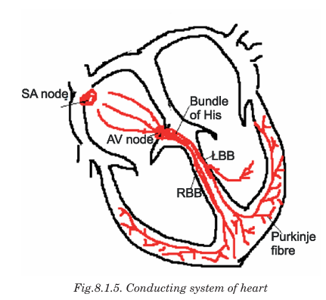

Slide 5
Conduction system of heart
SA Node → Atria contract
↓
AV Node → delay (0.1 sec)
↓
Bundle of His
↓
Right & Left Bundle Branches
↓
Purkinje Fibers → Ventricles contract

Slide 6
Unit 2

Slide 7
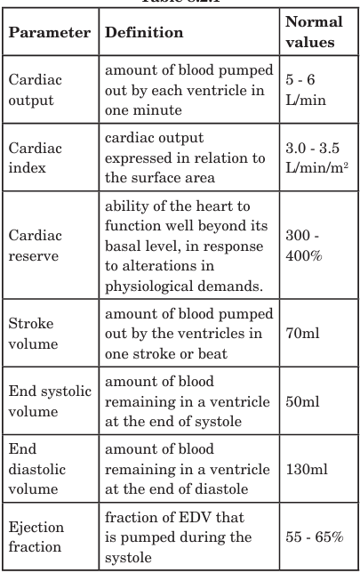

Slide 8
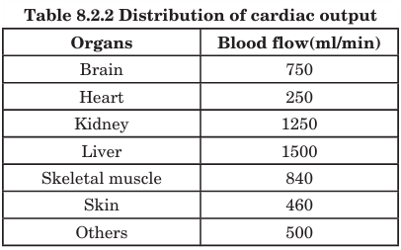

Slide 9
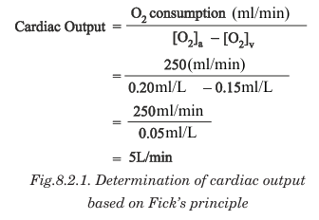

Slide 10
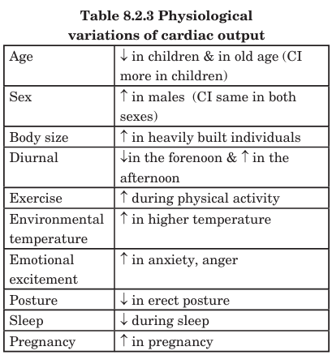

Slide 11
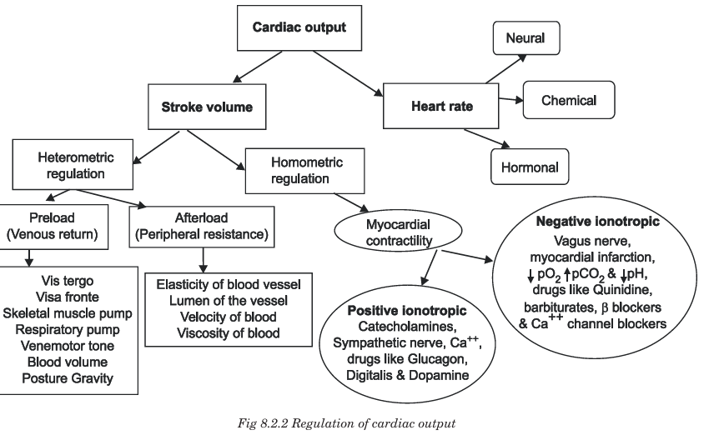

Slide 12
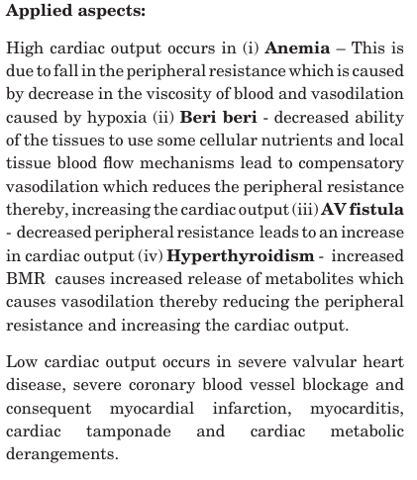

Slide 13
Unit 3

Slide 14
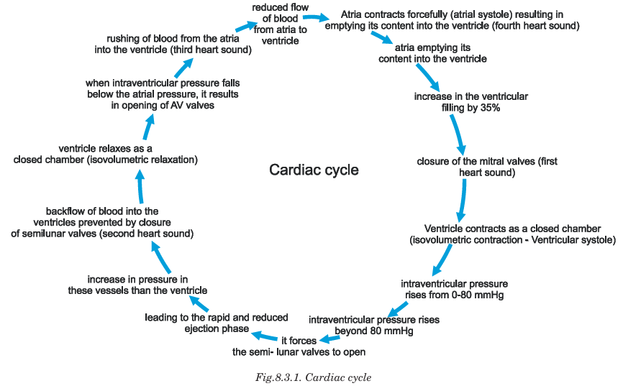

Slide 15
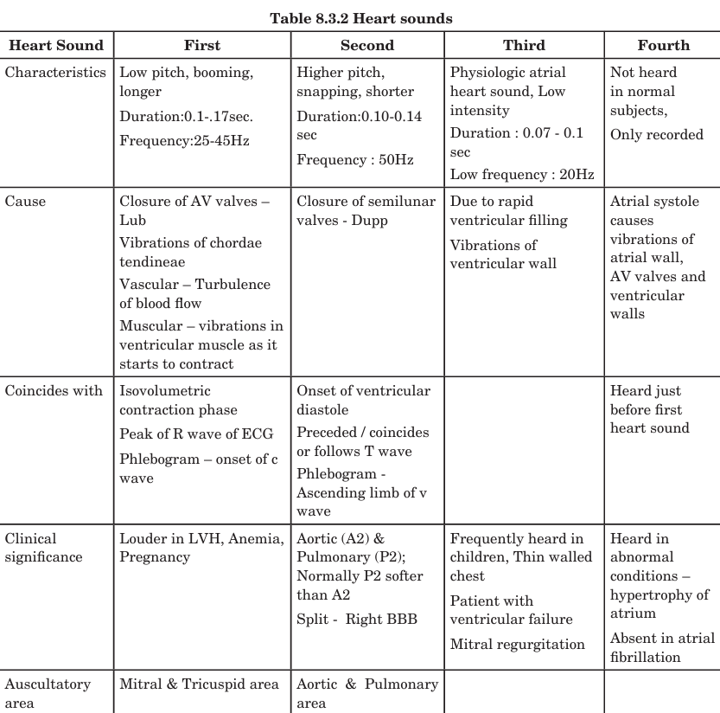

Slide 16
Unit 4

Slide 17
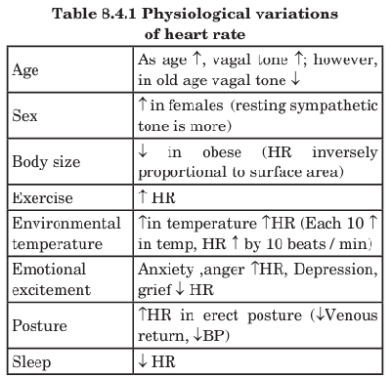

Slide 18
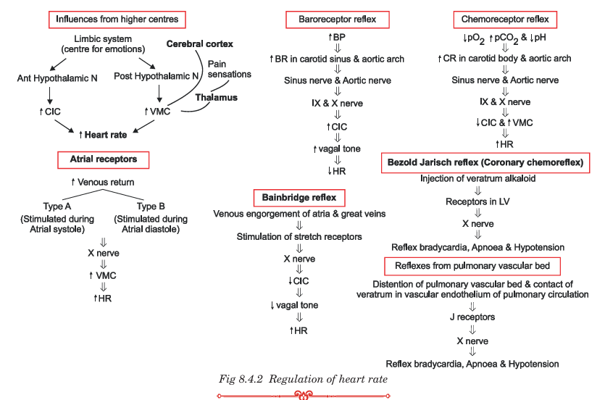

Slide 19
Unit 5

Slide 20
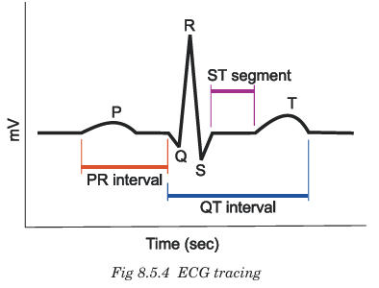

Slide 21
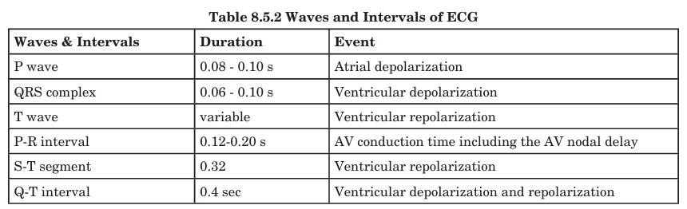
ECG

Slide 22
Condition | ECG Finding | Meaning
Tachycardia | HR > 100 bpm | Faster heart rate
Bradycardia | HR < 60 bpm | Slower heart rate
Condition | ECG Finding | Meaning
Atrial fibrillation | No clear P waves, irregular QRS | Atria beat irregularly
Ventricular fibrillation | Chaotic irregular waves, no QRST | Life-threatening, no effective pumping
Premature Ventricular Contraction (PVC) | Early broad QRS complex | Ventricular impulse arises early
Type | ECG Change | Meaning
First-degree block | Prolonged PR interval | Slowed conduction through AV node
Second-degree block | Some P waves not followed by QRS | Intermittent AV conduction
Complete / Third-degree block | P waves & QRS dissociated | No AV conduction — ventricles beat independently

Slide 23
Stage / Finding | ECG Feature | Interpretation
Ischemia | ST depression / T wave inversion | Reduced blood supply
Injury | ST elevation | Acute heart attack (STEMI)
Necrosis | Pathological Q wave | Dead cardiac tissue
Condition | ECG Change
Hyperkalemia (↑ K⁺) | Tall peaked T waves
Hypokalemia (↓ K⁺) | Flattened T waves + prominent U wave
Hypercalcemia (↑ Ca²⁺) | Short QT interval
Hypocalcemia (↓ Ca²⁺) | Long QT interval
Condition | ECG Sign
Left Ventricular Hypertrophy (LVH) | Tall R waves in left chest leads
Right Ventricular Hypertrophy (RVH) | Tall R waves in right chest leads
Atrial enlargement | Changes in P wave shape

Slide 24
Unit 6

Slide 25
Hemodynamics — Definition and Explanation
Hemodynamics is the study of the physical principles that regulate the flow of blood in the circulatory system.
It explains how blood pressure, blood flow, and resistance interact to ensure proper distribution of blood to all tissues.

Slide 26

Key Principles of Hemodynamics
1. Blood Flow (Q)
Amount of blood that passes through a vessel per unit time.
Formula:
$Q∝\frac{ΔP}{R}$
  Q = Flow
  ΔP = Pressure difference between two ends
  R = Resistance
➡ Blood flows from higher pressure → lower pressure
2. Blood Pressure
Force exerted by the blood on the walls of blood vessels.
Highest in aorta, lowest in vena cava.
Regulated by cardiac output & peripheral resistance.

Slide 27

Poiseuille’s Law:
$R∝\frac{1}{r^{4}}$
Even small decrease in radius → big rise in resistance
Pulse Pressure
$\text{Pulse} \text{Pressure}=\text{Systolic} \text{BP}−\text{Diastolic} \text{BP}$
Indicates stroke volume and elasticity of arteries.
Cardiac Output (CO)
$CO=HR×SV$
HR = Heart rate
SV = Stroke volume

Slide 28
Hemodynamics in different vessels
Vessel Type | Main Feature
Arteries | High pressure, low compliance
Arterioles | Major resistance vessels (control BP)
Capillaries | Maximum area + slowest flow → efficient exchange
Veins | Low pressure, high compliance → blood reservoir

Slide 29
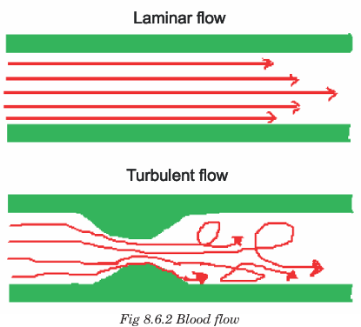

Slide 30
Unit 7

Slide 31
Blood Pressure (BP) — Definition
Blood pressure (BP) is the lateral force exerted by the blood on the walls of the arteries during circulation.
It is expressed in millimetres of mercury (mmHg).
Type | Meaning | Normal Value
Systolic BP (SBP) | Pressure during ventricular contraction | 120 mmHg
Diastolic BP (DBP) | Pressure during ventricular relaxation | 80 mmHg
Pulse Pressure | SBP – DBP | 40 mmHg
Mean Arterial Pressure (MAP) | Effective pressure driving blood to tissues | ≈ 93 mmHg

Slide 32
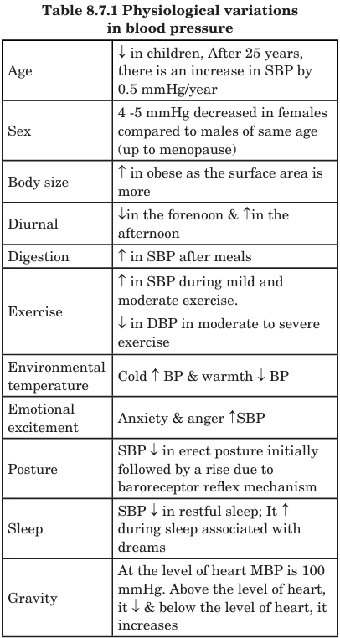

Slide 33
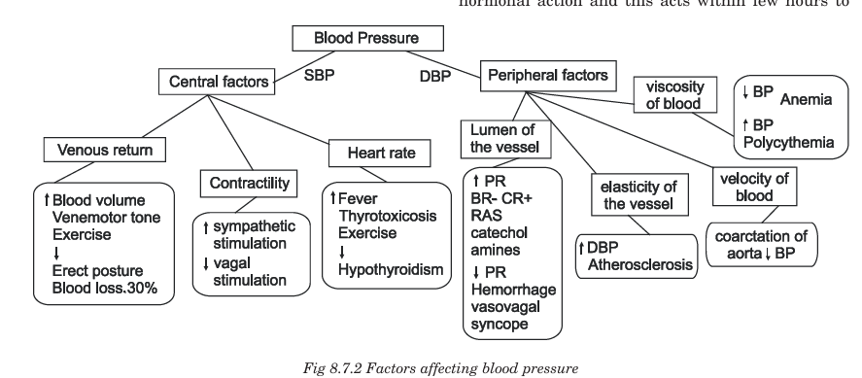

Slide 34
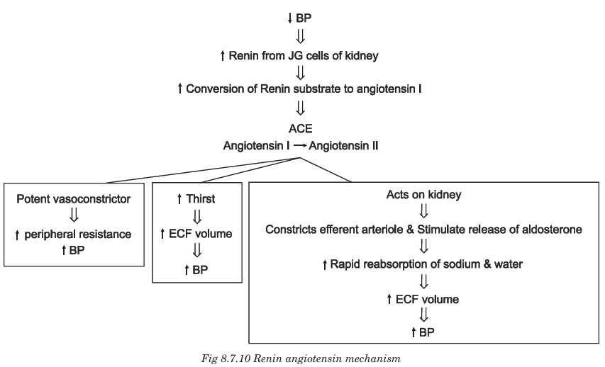

Slide 35
Unit 8

Slide 36
Shock — Definition
Shock is a life-threatening condition in which there is inadequate blood flow (perfusion) to tissues, leading to insufficient oxygen and nutrients and accumulation of waste products.
If not treated early, it can result in cellular injury, organ failure, and death.
Type | Cause | Example
Hypovolemic shock | Severe loss of blood or fluids | Hemorrhage, burns, dehydration
Cardiogenic shock | Pump failure of the heart | Myocardial infarction, heart failure
Distributive / Vasogenic shock | Excessive vasodilation → blood pooling | Sepsis, anaphylaxis, neurogenic shock
Obstructive shock | Physical obstruction to blood flow | Pulmonary embolism, cardiac tamponade, pneumothorax
Mixed shock | Combination of types | Trauma with bleeding + inflammation

Slide 37
Unit 7

Slide 38
Systemic Circulation — Definition
Systemic circulation is the pathway in which oxygenated blood from the left ventricle is distributed to all body tissues (except lungs), and deoxygenated blood returns to the right atrium.
It is the major circulation supplying nutrients and oxygen to the entire body.

Slide 39
Left Ventricle
↓ (via Aortic valve)
Aorta
↓
Arteries
↓
Arterioles
↓
Capillaries — (exchange of gases, nutrients & waste)
↓
Venules
↓
Veins
↓
Superior & Inferior Vena Cava
↓
Right Atrium

Slide 40
Coronary vs cerebral circulation
Feature | Coronary | Cerebral
Main blood flow phase | Diastole | Continuous
Oxygen extraction | Very high | High
Collateral circulation | Poor | Very good (Circle of Willis)
Regulation | Metabolic | Metabolic + Autoregulation
Effect of pressure changes | Significant | Minimal (autoregulated)
Compression during systole | Yes | No
Clinical risk | MI | Stroke

